Slide 1
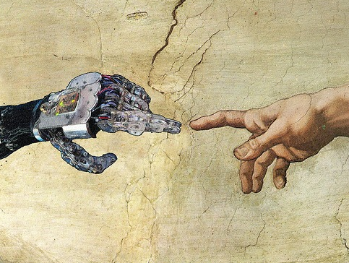
Introduction to Human Interaction Robotics
Build a Robot to Help Human Life
ESP/WIE 2016
Complete pre-survey;
Create groups;
Learn the fundamentals on interaction robotics;
Understand the function of the Neu-Pulator;
Learn how to use Arduino IDE;
Implement a simple robotic system.

Slide 2
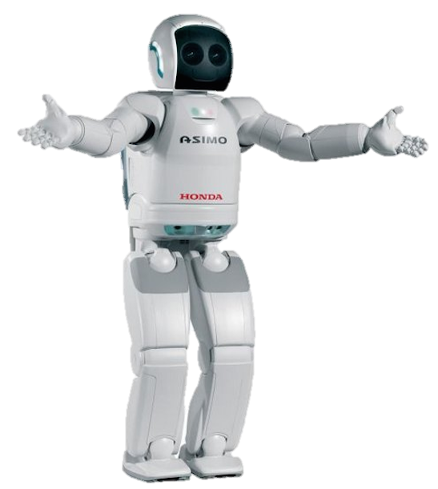
Neu-pulator project the week in a glance
Intro to Human Interaction Robotics
Pre-Survey
Team Selection
Overview Project
Sensors and Actuators
Input Devices: Potentiometer
Servomotor
Micro Robotic Arm
Mechanical Assembly
Assembly of the Neu-Pulator
Human Body Instrumentation
EMG Sensor
Testing the Neu-Pulator
Robotic Arm Reaching Challenge
Challenge
Post-Survey
Post-Interview

Slide 3
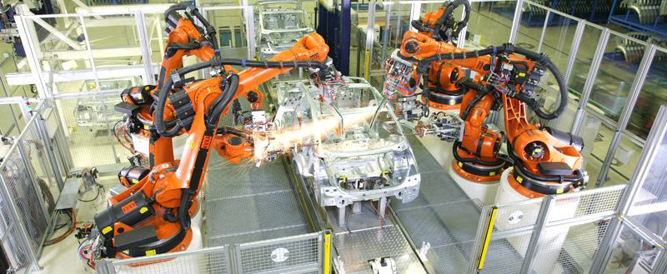
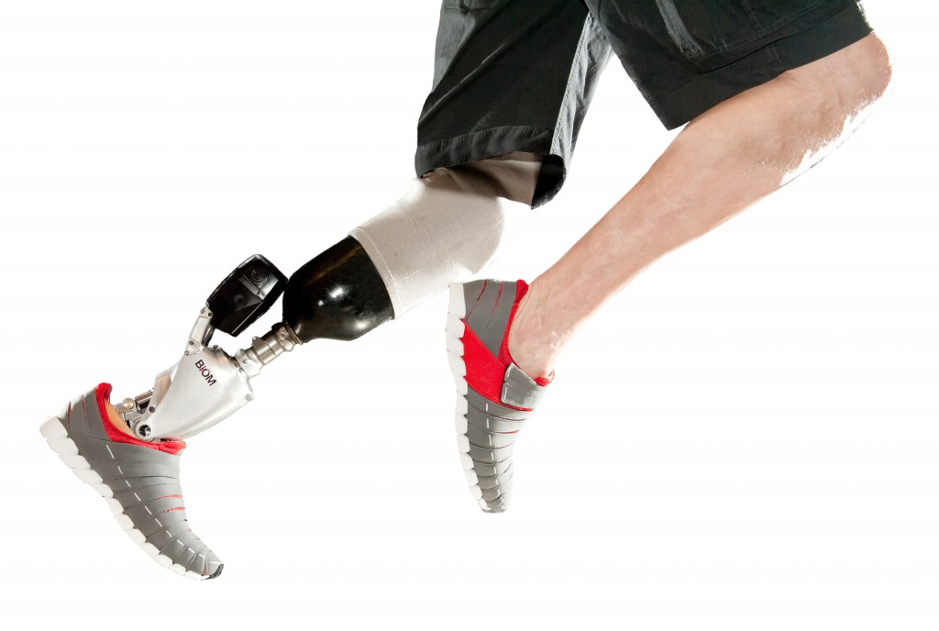
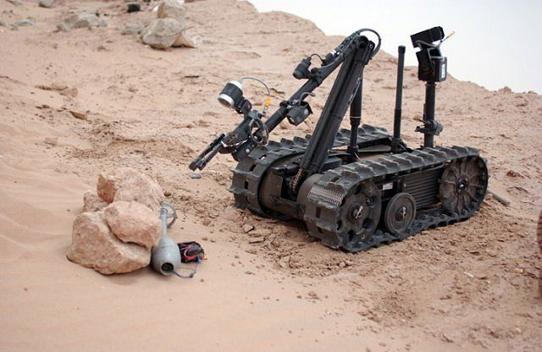
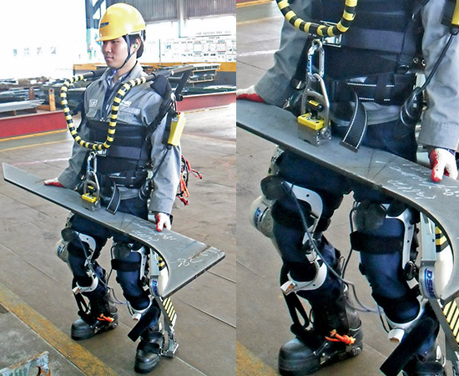
Fundamentals on Robotics
Applications: Automation, Teleoperation, Power Augmentation, Prosthetics
Components: Controller, Sensors, Actuators

Slide 4
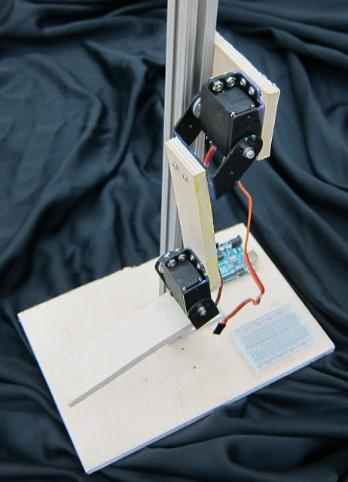
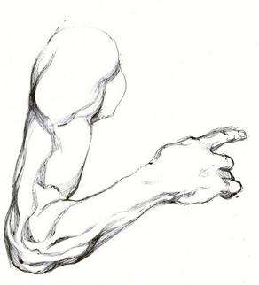
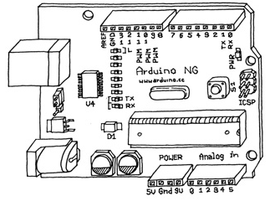
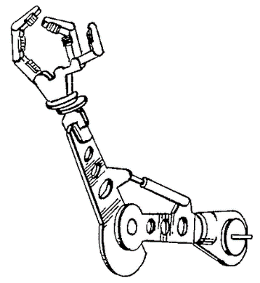
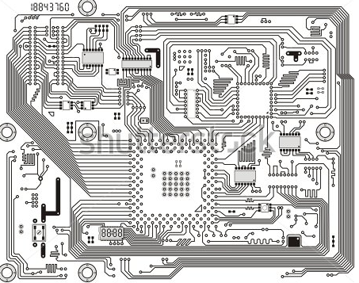
Neupulator robot
Bionic Arm
“Neuron” + “Manipulator” = “Neu-pulator”
Let’s see an example!
Demonstration of the Neu-Pulator
Human Motion
Muscle Activation Sensor
Controller Board
Robot Motion

Slide 5
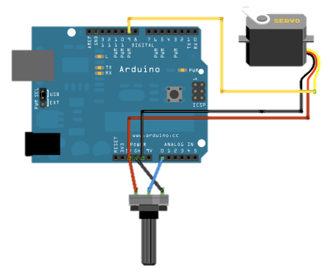
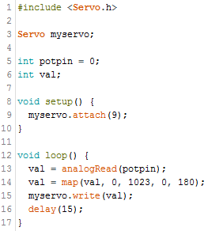
Building a simple robot
Open Arduino IDE for live demo
Potentiometer generates signal
Servomotor actuates

Slide 6

Programming, Sensors and actuators
Understand what is a sensor (eg. potentiometer) and how to use it;
Understand what is a actuator (eg. servomotor) and how to use it;
Implement a simple robotic arm.
Build a Robot to Help Human Life
ESP/WIE 2016

Slide 7
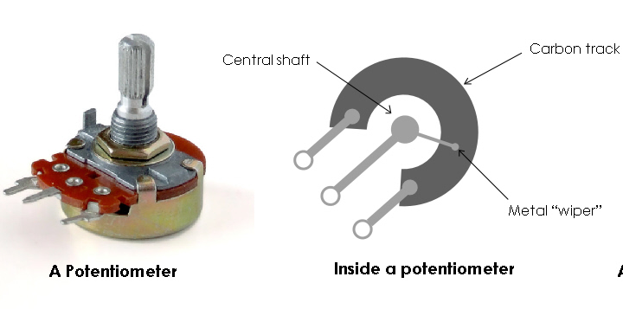
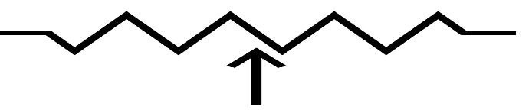
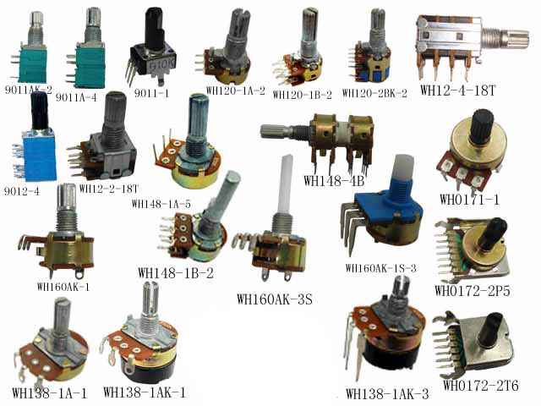

Signal inputs: potentiometer
AnalogReadSerial
Convert sensor value to voltage

Slide 8
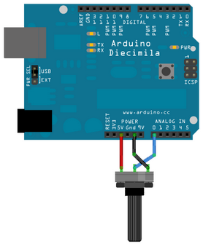
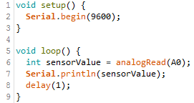
Reading Sensors
Example > Basics > AnalogReadSerial
Convert sensor value to voltage

Slide 9
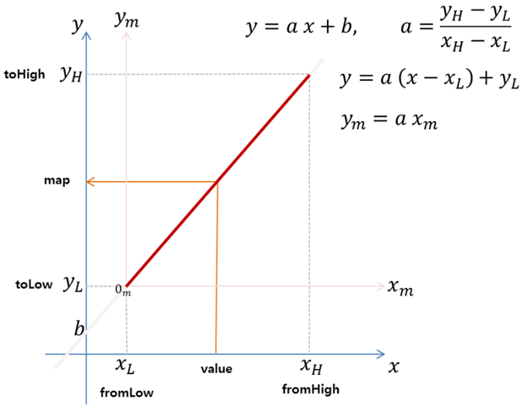
Reading sensors: converting ranges

Slide 10
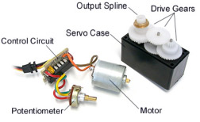
Actuator: servomotor

Slide 11
Generating Motion
Example > Servo > Knob
Change the output angle mapping to 30-150 deg

Slide 12
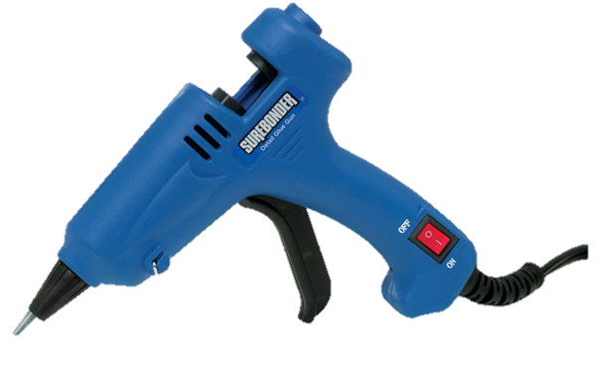
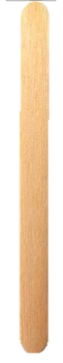
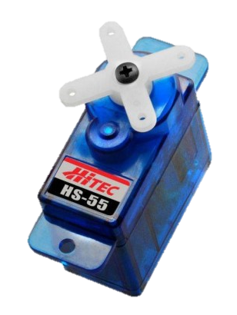
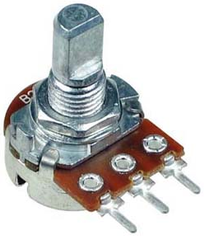

Building a Simple Robotic Arm
Dual Knob example
BRING IT ON!

Slide 13
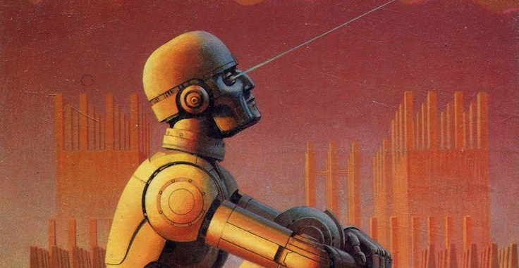
Mechanical Assembly of the Neu-pulator
Build a Robot to Help Human Life
ESP/WIE 2016
Learn basic mechanical elements;
Assemble the servomotor modules, links and base;
Center the servomotor range of motion.

Slide 14
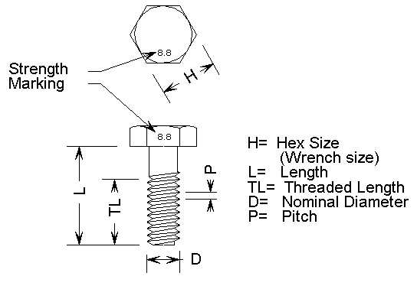
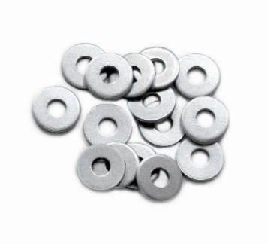
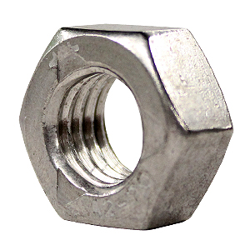
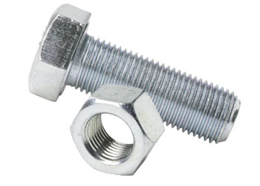
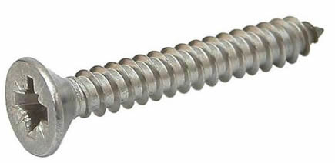
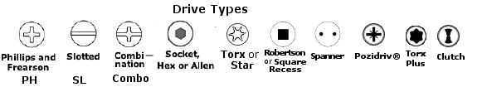
Mechanical Parts
MD x P x L
Mechanical elements
Screw notation
Head types
Screw
Bolt
Washer
Nut

Slide 15
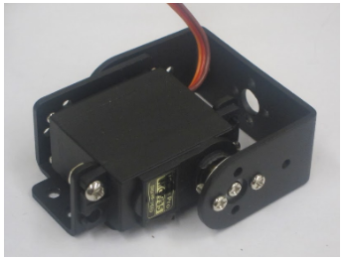
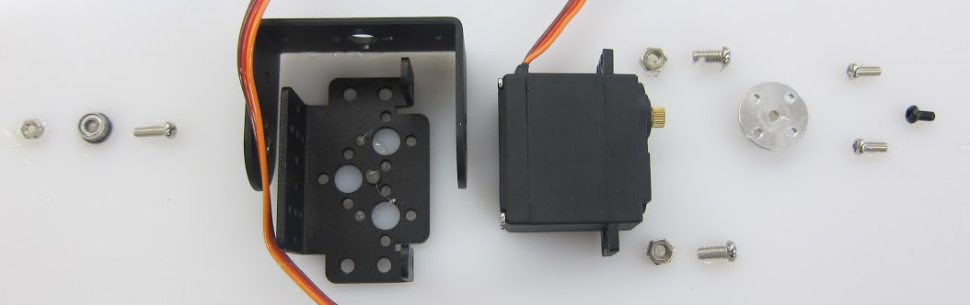
Assembly Steps: Servomotor Modules
C-Shaped
Bracket
Bearing
Screw
Multipurpose
Bracket
Nut
Horn
Bolt

Slide 16
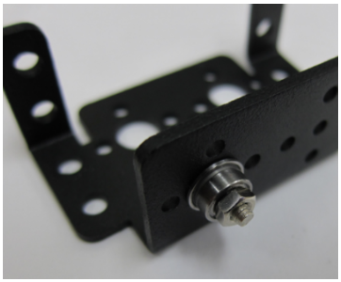
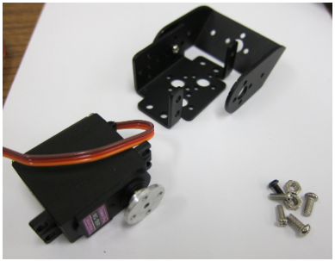
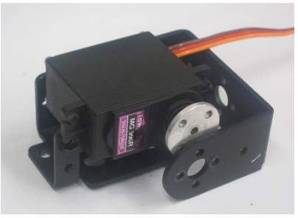
Assembly Steps: Servomotor Modules
Bolt in the bearing
Align C-shaped bracket
Into bearing
Insert servomotor
Between the brackets
Do all the screws
and bolts

Slide 17
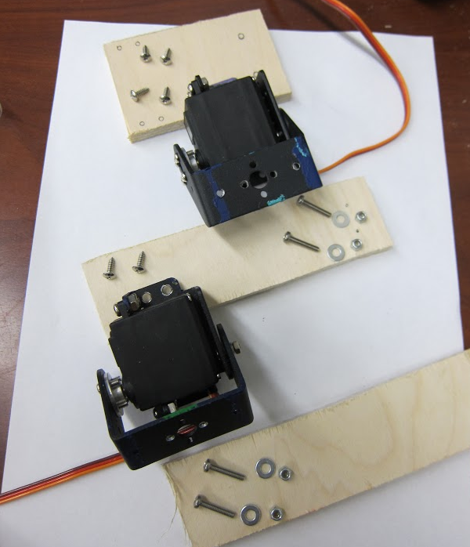
Assembly Steps: Links and adapter
6 M3 screws
4 M3 x 1.5 x 15
4 M3 washers
4 locking nuts
Adapter
2 servomotor modules
2 links

Slide 18
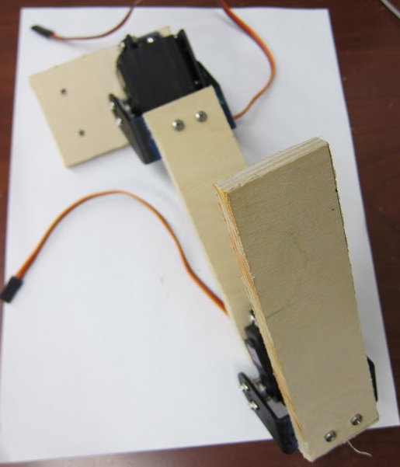
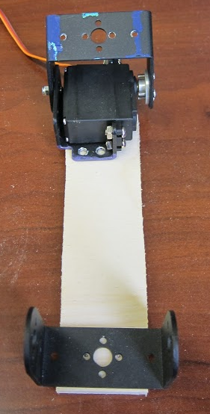
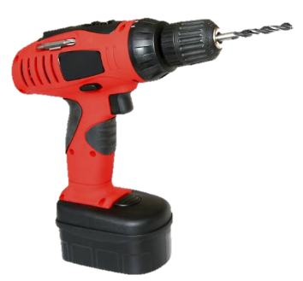
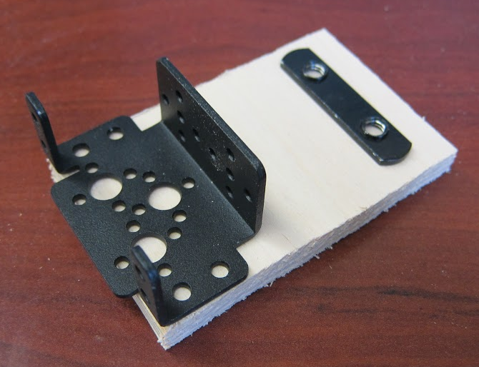

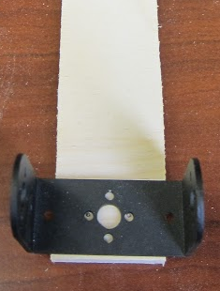
Assembly Steps: Links and adapter
M3
M6
M4
Adapter
M3
M4
Make pilot holes
Mid-Link
End-Link

Slide 19
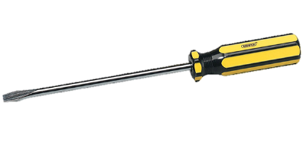
Assembly Steps: Links and adapter
Tight screws and bolts

Slide 20
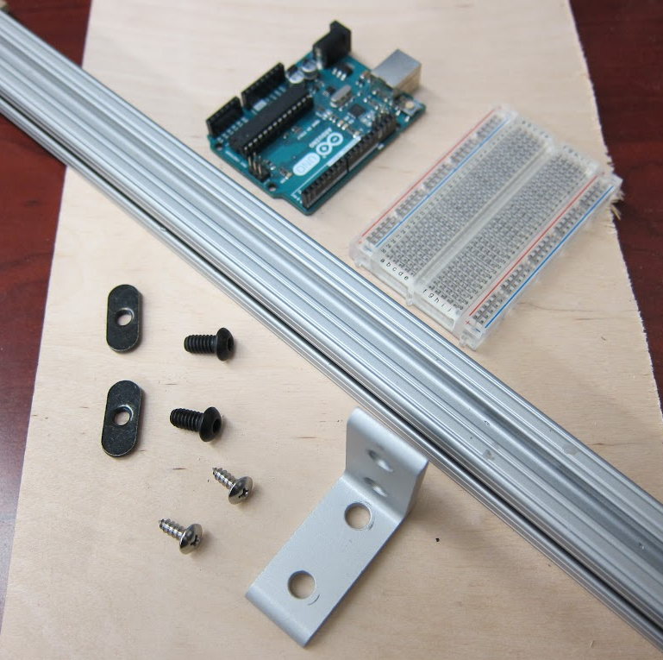
Assembly Steps: Base
Arduino
Breadboard
50 cm long 80/20 bar
Base
2 80/20 nut
2 M3 x 1.5 x 15 bolt
2 M5 x 1.5 x 15 self-tapping screws
L bracket

Slide 21
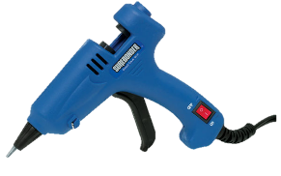
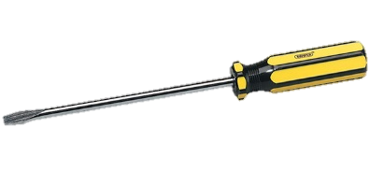
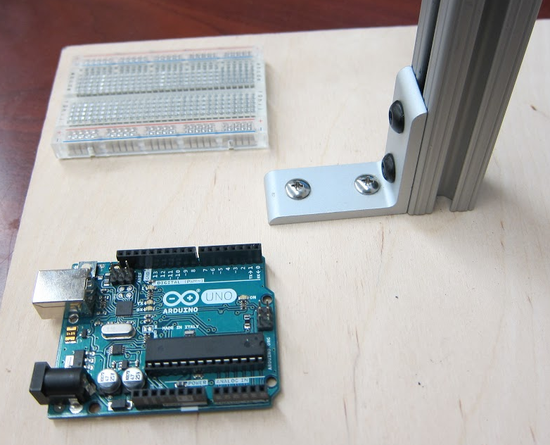
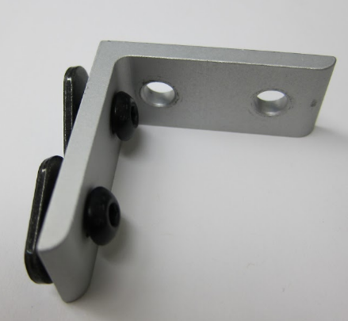
Assembly Steps: Base
Screw the washers in place
Hot glue Arduino and breadboard
Make pilot holes for screws on base
Connect the arm to the bar
With the adapter
Screw bar in place

Slide 22

Human Body Instrumentation
Introduce the use of EMG;
Live demonstration on where to place the EMG electrodes and how to wire it;
Control the Neu-Pulator with the EMG sensor.
Build a Robot to Help Human Life
ESP/WIE 2016

Slide 23
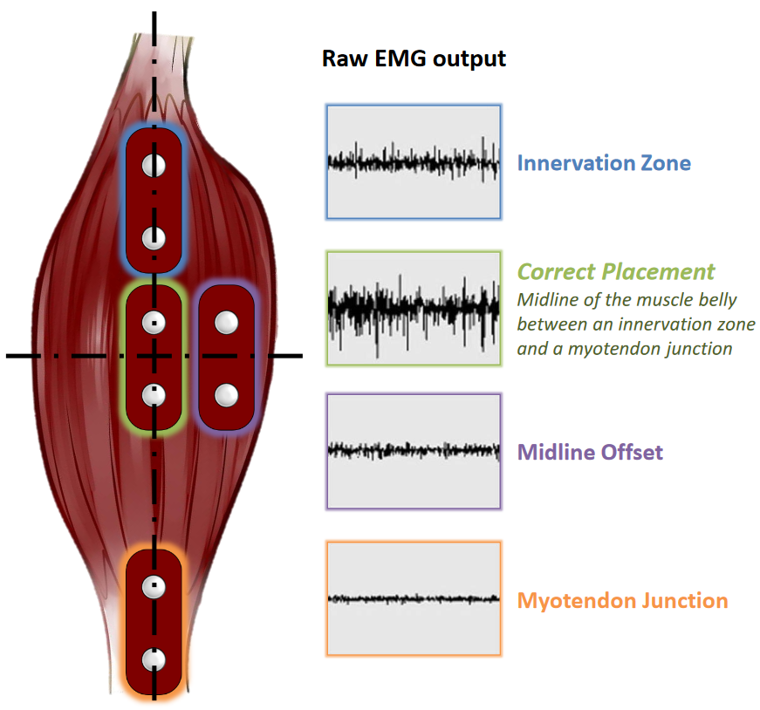
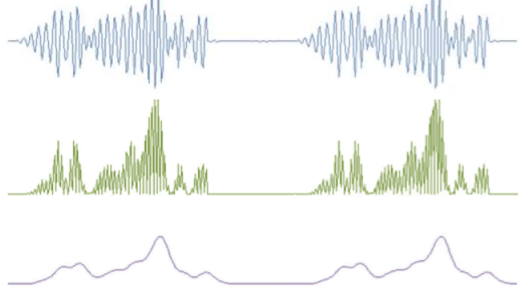
Sensing Human Motion: EMG
Electromyography
Muscle rehabilitation
Amplification, Rectification and Filtering
Let’s see an example!
Live demonstration

Slide 24

Wiring the EMG Sensor
+
-
SIG
Works as a potentiometer;
Use breadboard to get a second 5 V power connection and power the second sensor

Slide 25

Neu-pulator algorithm
sensorMax and sensorMin are calibration parameters (Example > Analog > Calibration)

Slide 26


Neu-pulator algorithm

Slide 27

Robotic Arm Reaching Challenge
Build a Robot to Help Human Life
ESP/WIE 2016
Complete post-survey;
Complete interview;
Excel at the Final Challenge.

Slide 28
Final challenge rules
1. Reach for the Runner Manipulator
2. Groups have 3 tries: One for each group member
3. Highest score defines the group points
1. Reach for the Runner Manipulator
2. Groups have 3 tries: One for each group member
3. Highest score defines the group points

